Slide 1
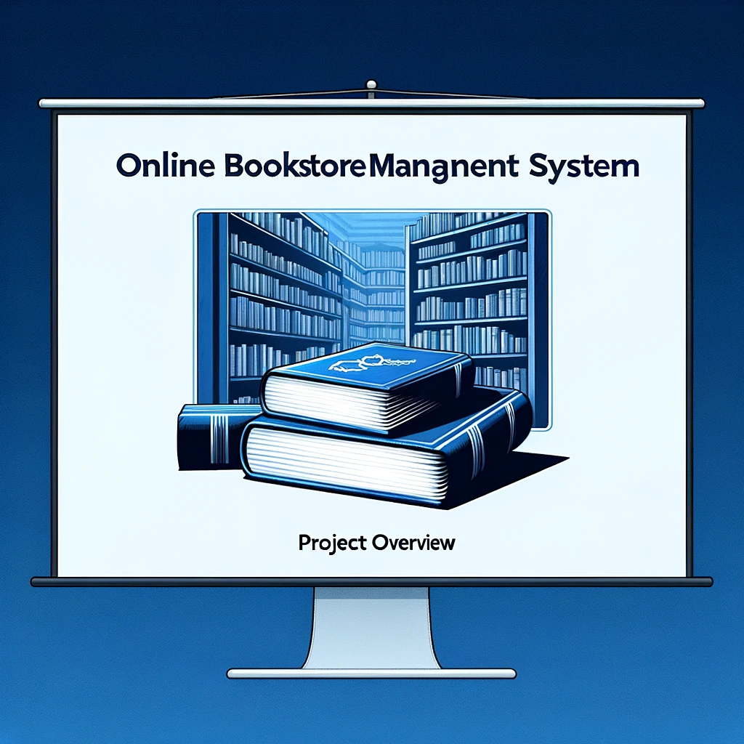
Online Bookstore Management System
Created by: JAMES FALLOUH 6171620

Slide 2
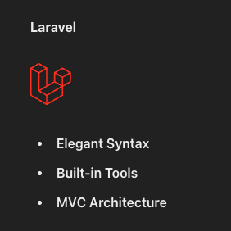
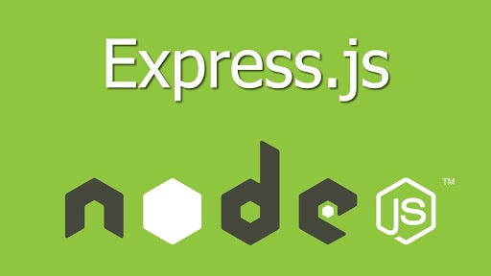

Spring VS Laravel Vs Express

Slide 3
Templating engine
Spring: Thymeleaf
Lavavel: Blade
Express: EJS (Embedded JavaScript), Pug, or Handlebars

Slide 4
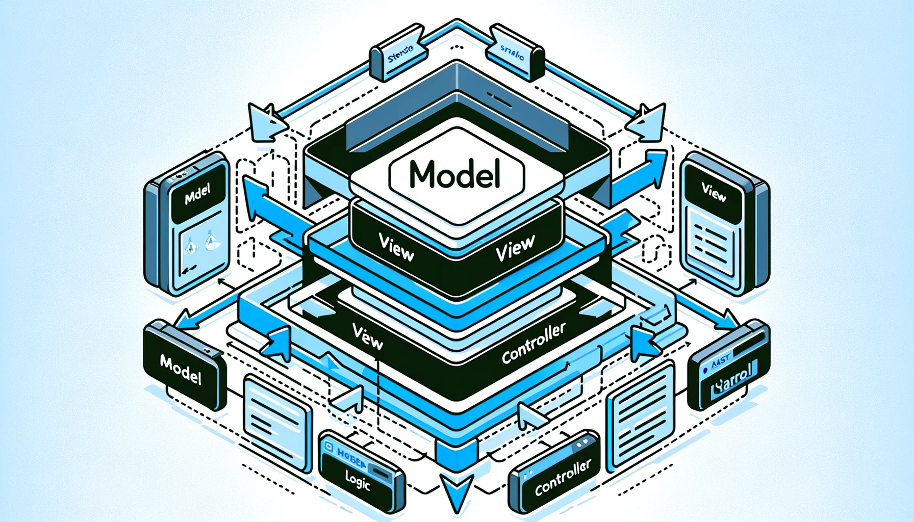
MVC spring:
Model: Represents the data and the business logic. It interacts with the database and defines the classes and methods to manipulate the data.
View: The user interface. It is what the user sees and interacts with, often implemented using a templating engine (like Thymeleaf in Spring).
Controller: Acts as the middleman. It receives user input (requests), processes it (often involving the model), and returns the appropriate view.
Model handles the data and business logic.
View handles what the user sees and interacts with.
Controller handles user input and coordinates between the Model and View.

Slide 5
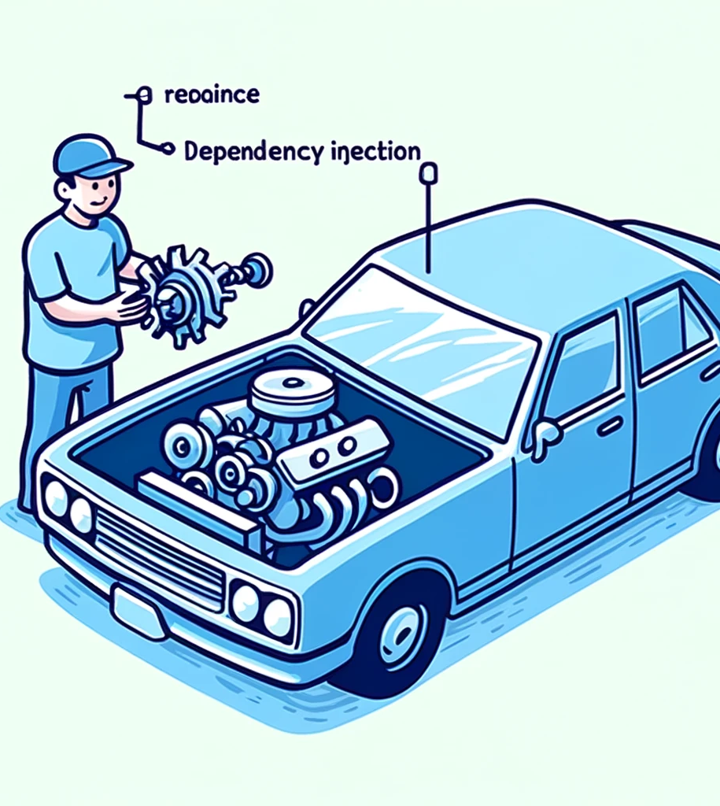
Dependency Injection and Inversion of Control
Dependency Injection and Inversion of Control in Spring are ways to separate the responsibilities of different parts of an application.

Slide 6
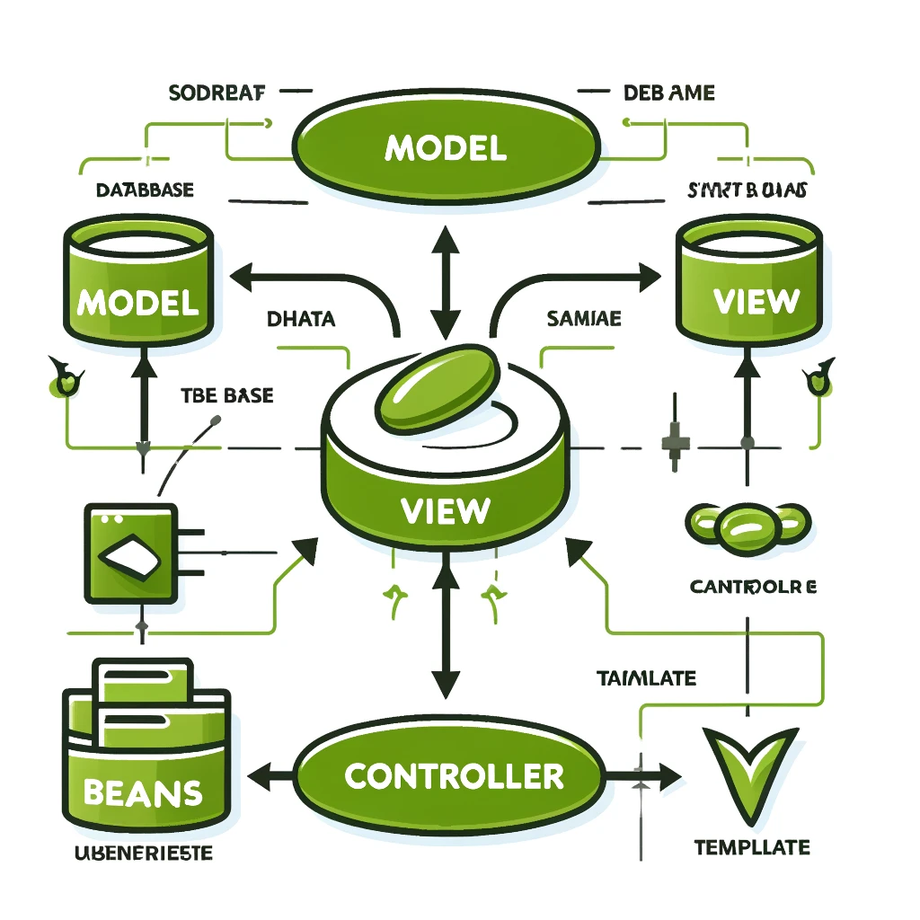
Beans
Beans are the way Spring applies dependency injection and inversion of control.
A Bean is an instance of a class that is managed by the Spring container.

